Slide 1
Makers, Hackers, and Badges at the Denver Public Library
Zeth Lietzau, Manager
Community Technology Center / Digital User Experience

Slide 2
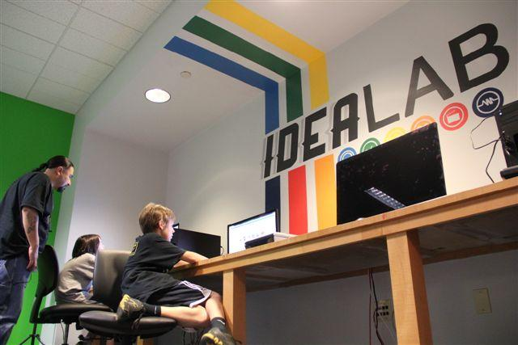

Slide 3
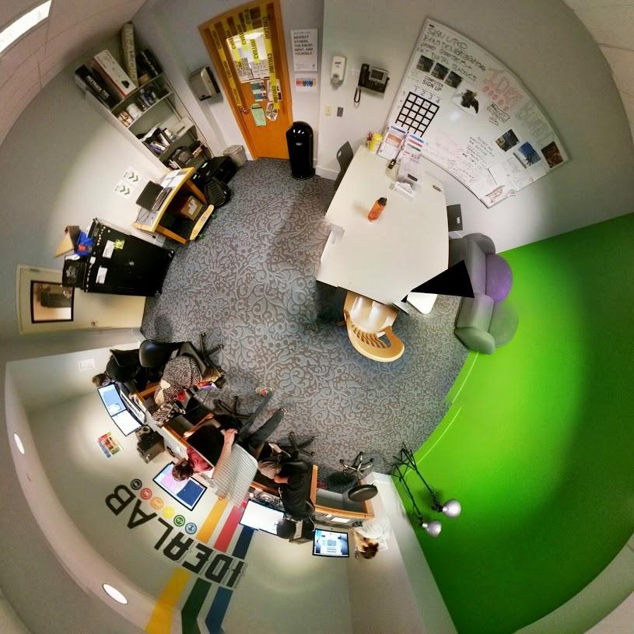

Slide 4
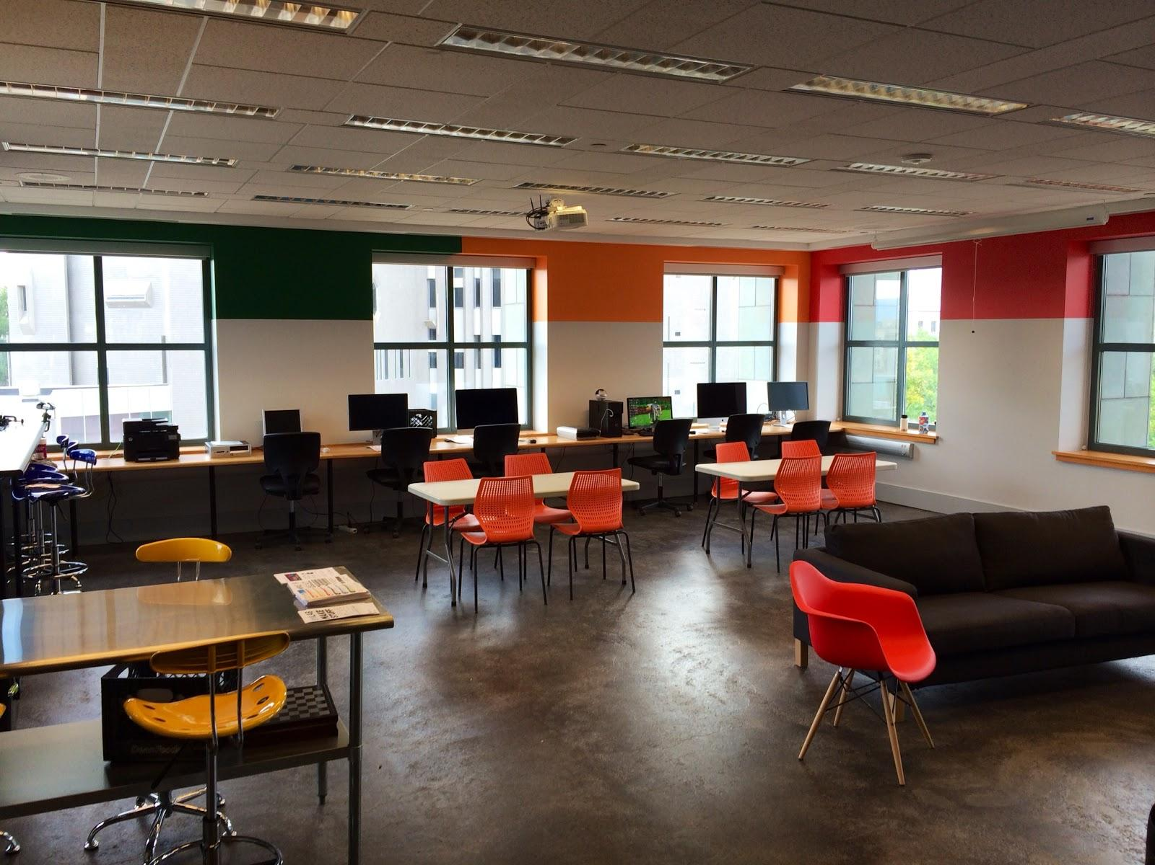

Slide 5
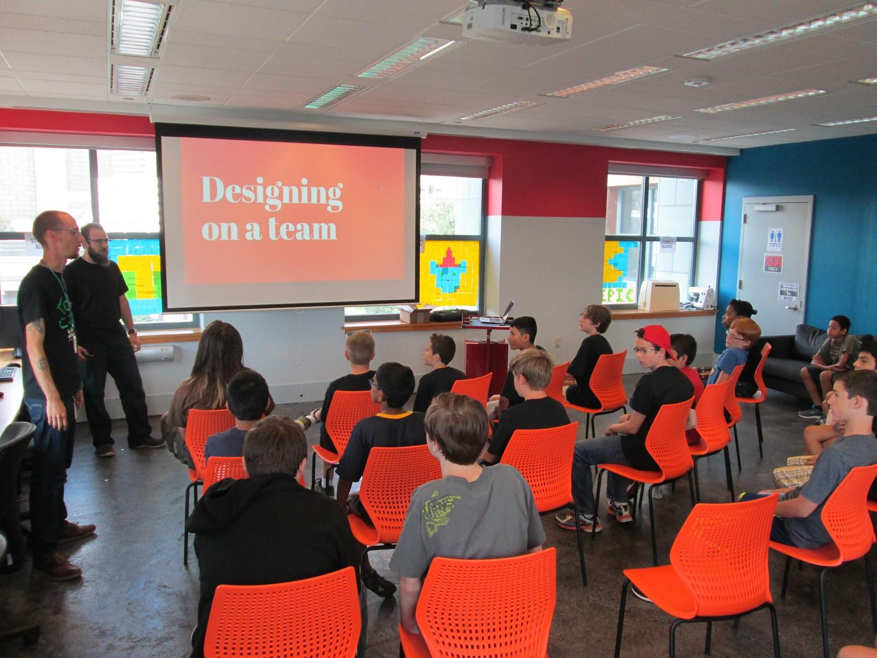

Slide 6
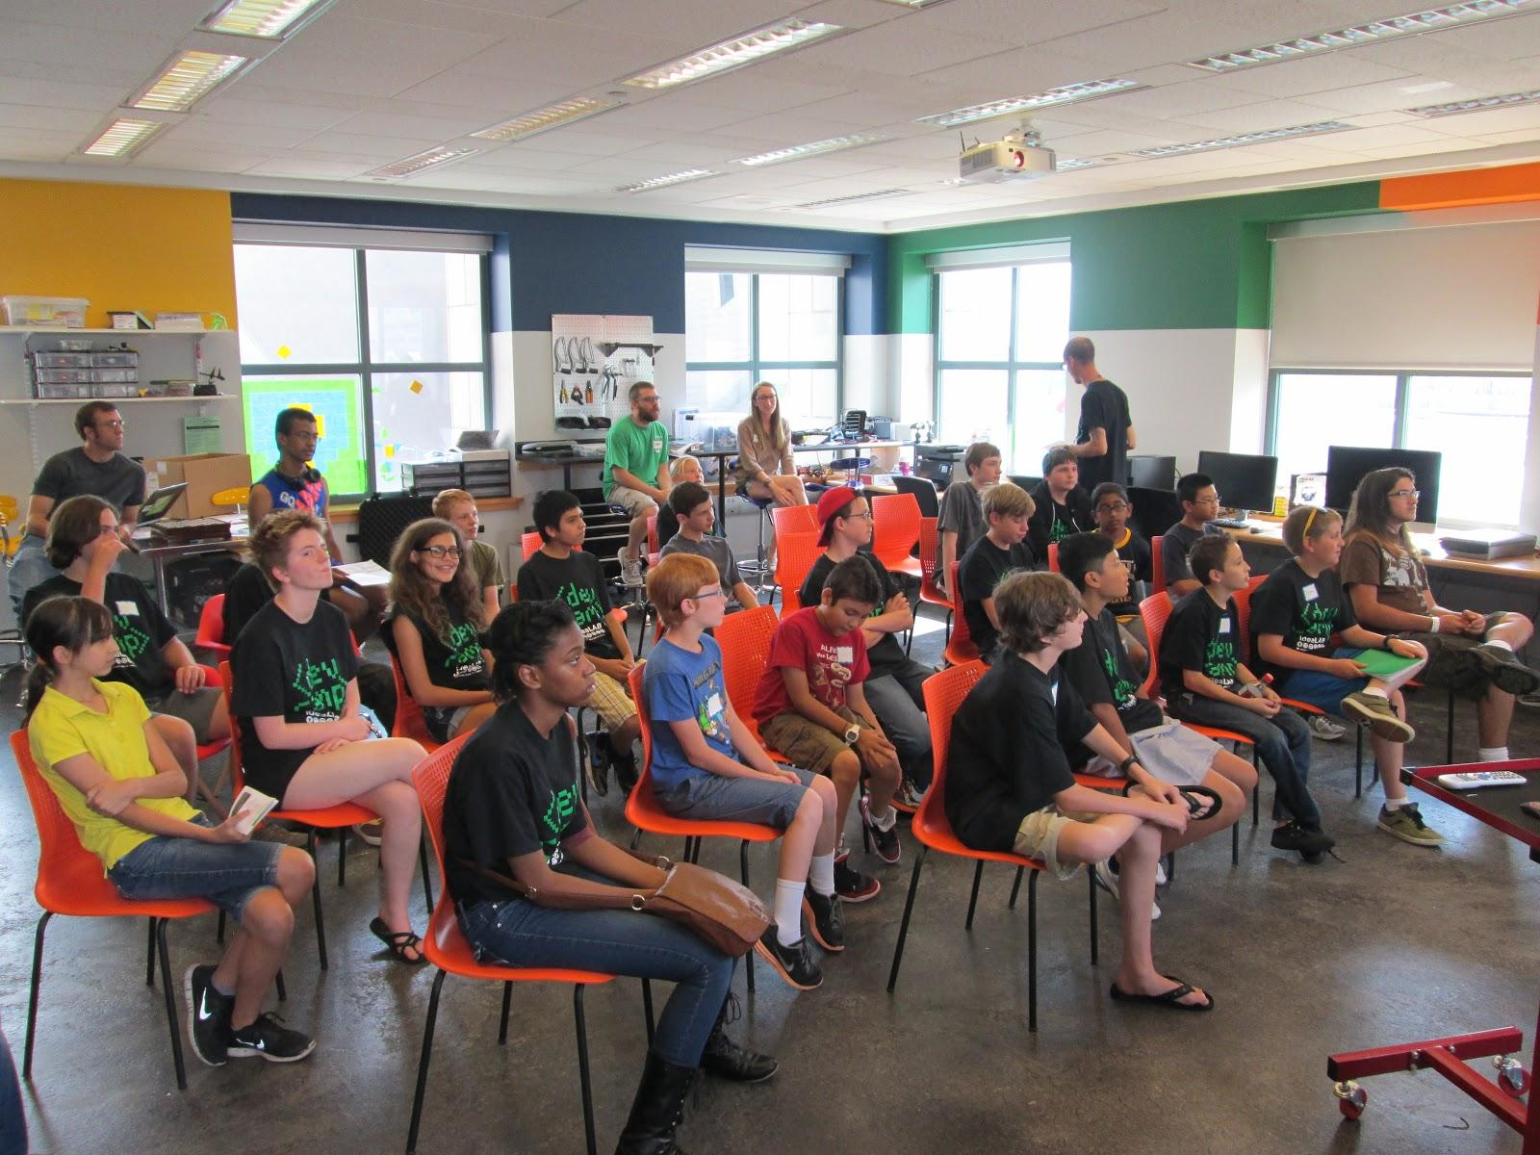

Slide 11
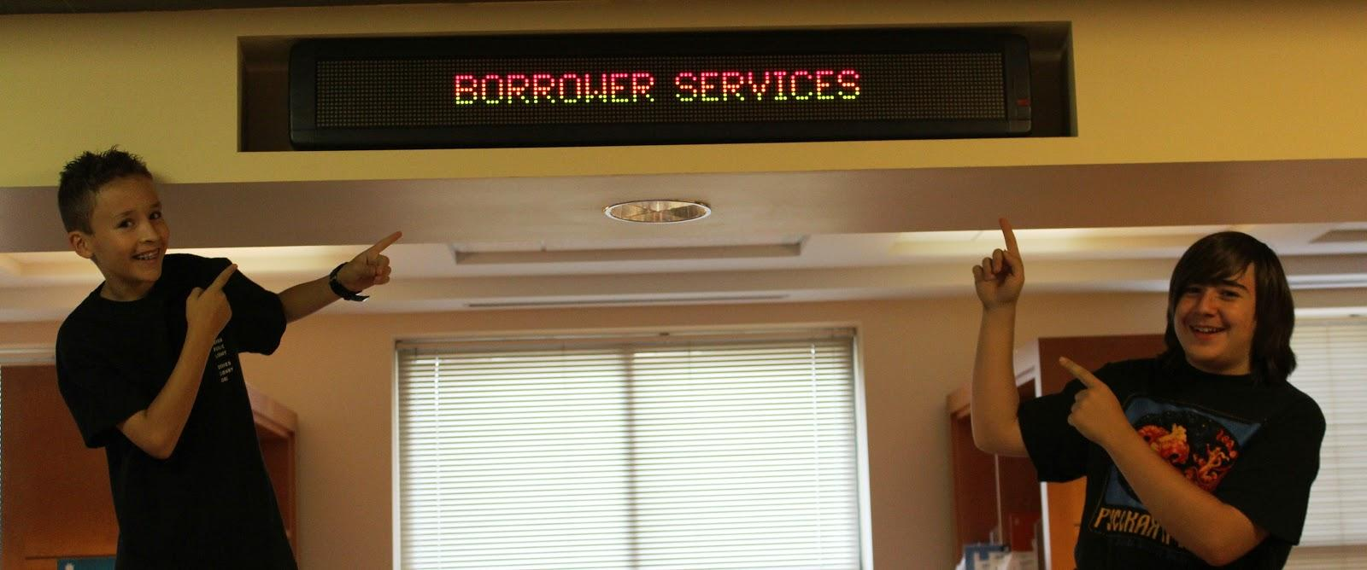

Slide 12
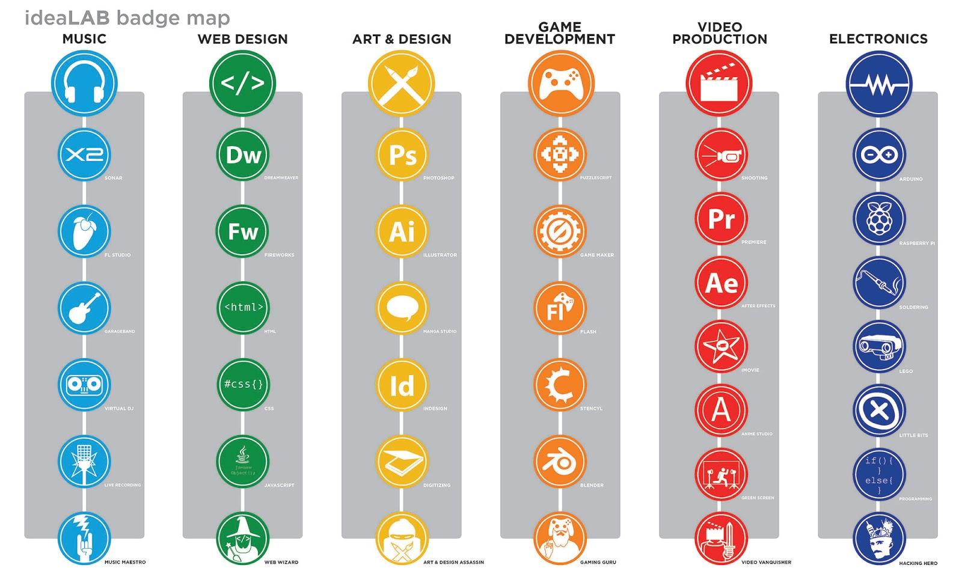

Slide 13
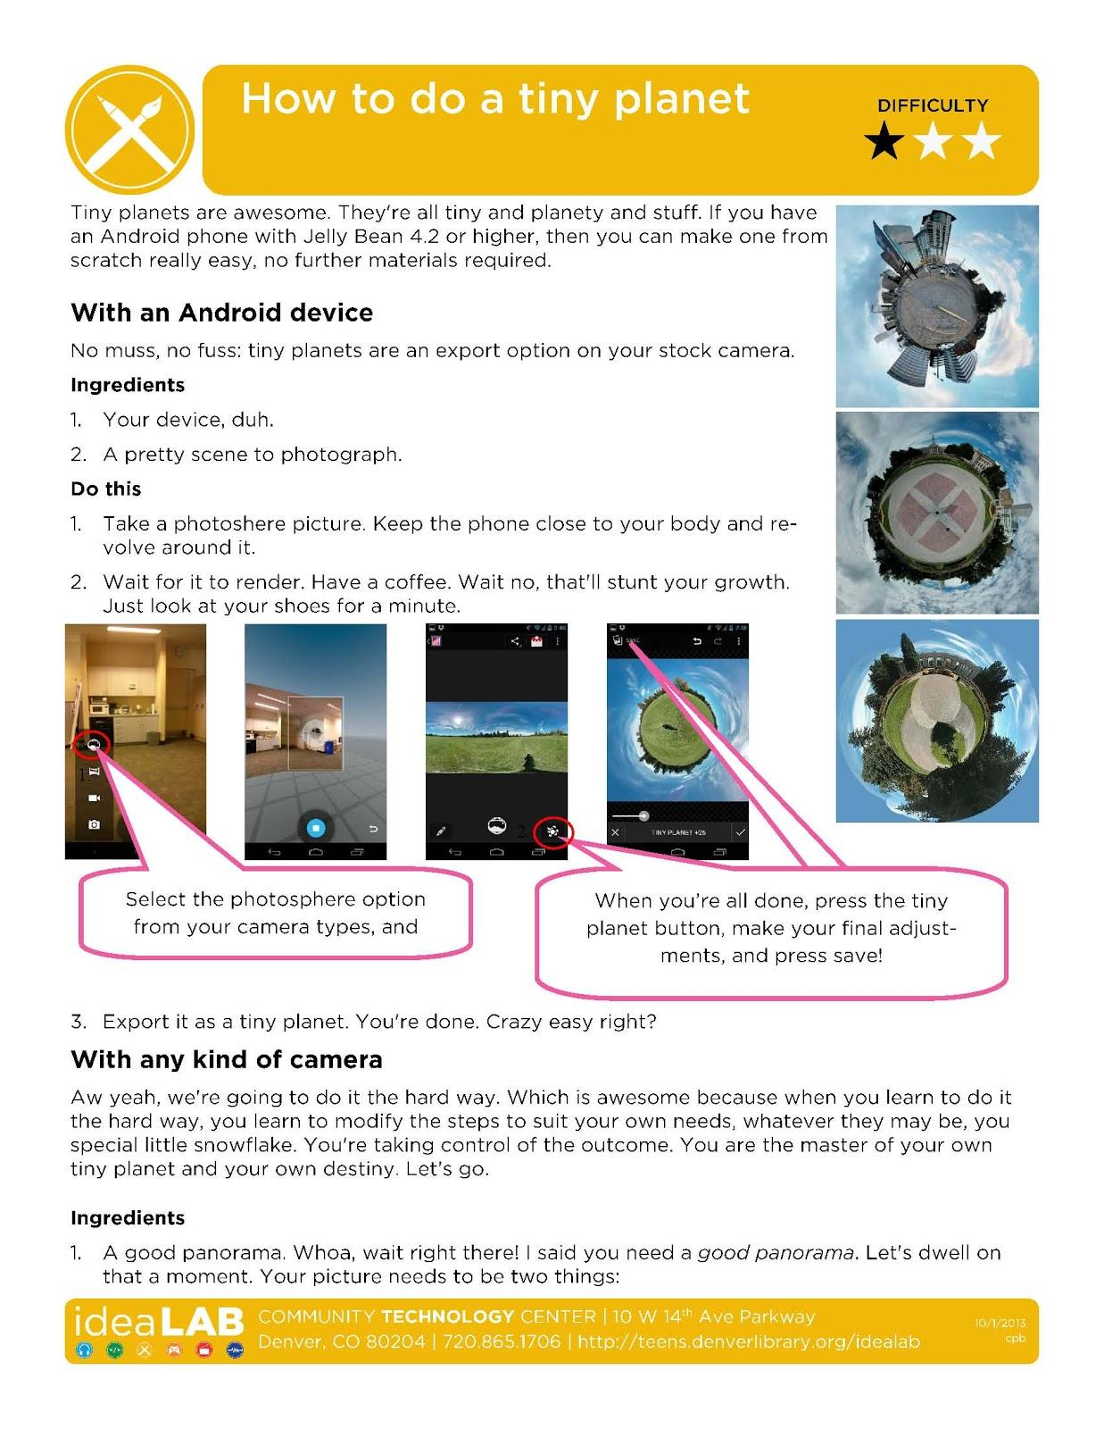

Slide 14
So Why Badge?
https://www.flickr.com/photos/dark_imp666/2119349952

Slide 15
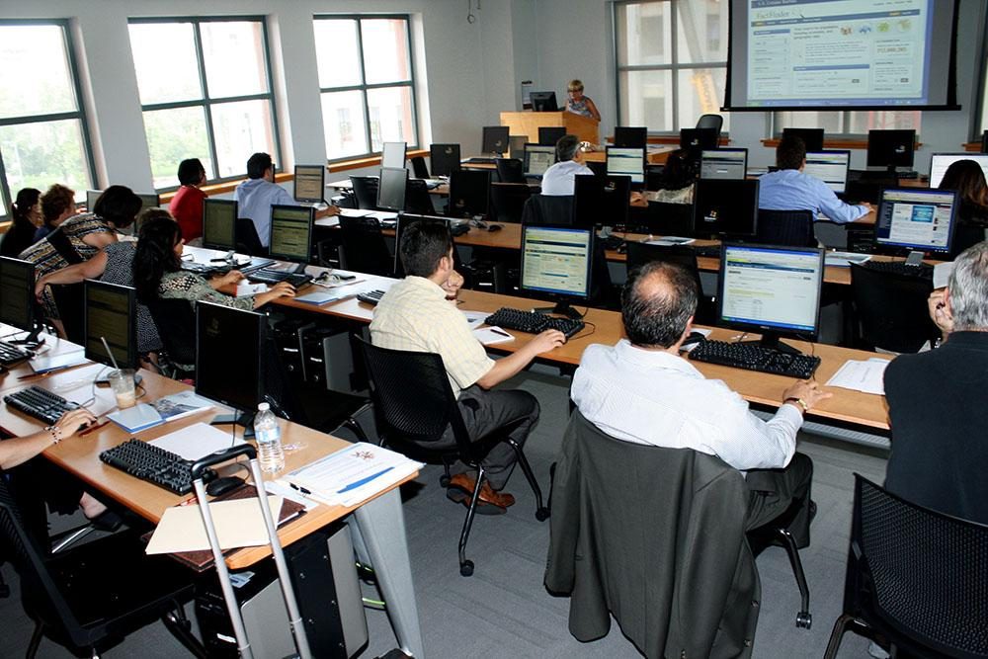

Slide 16
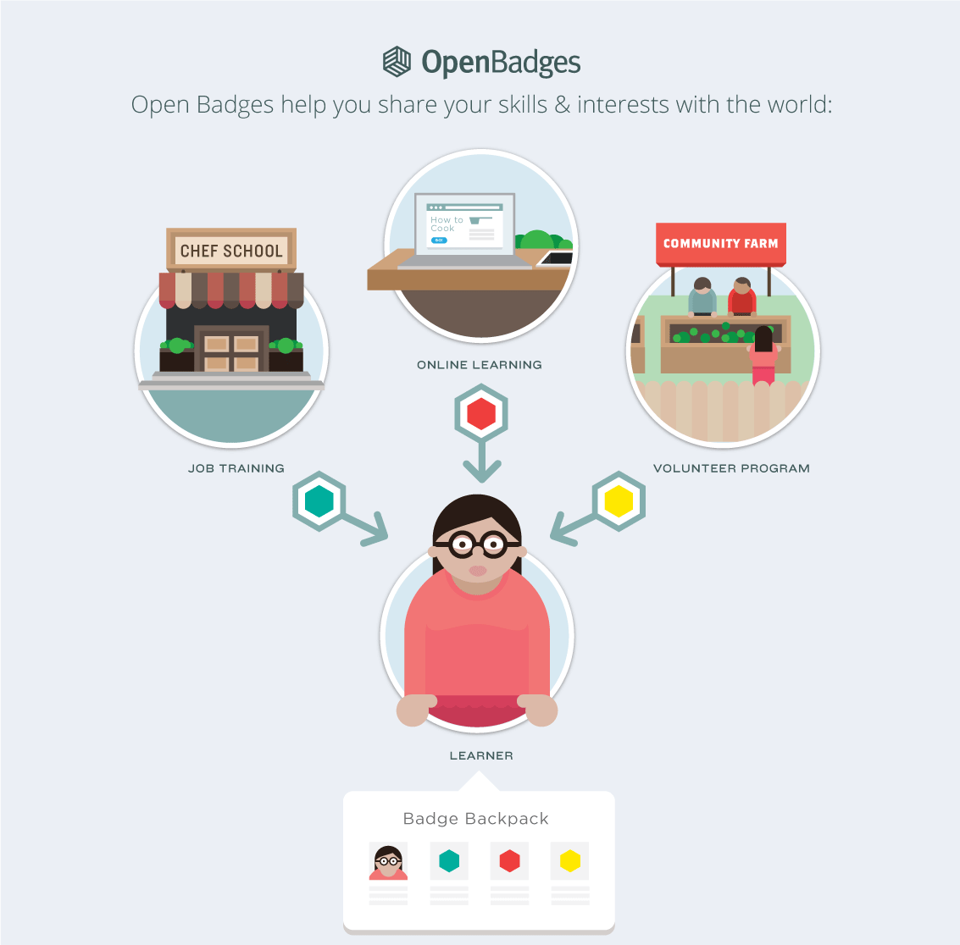

Slide 17
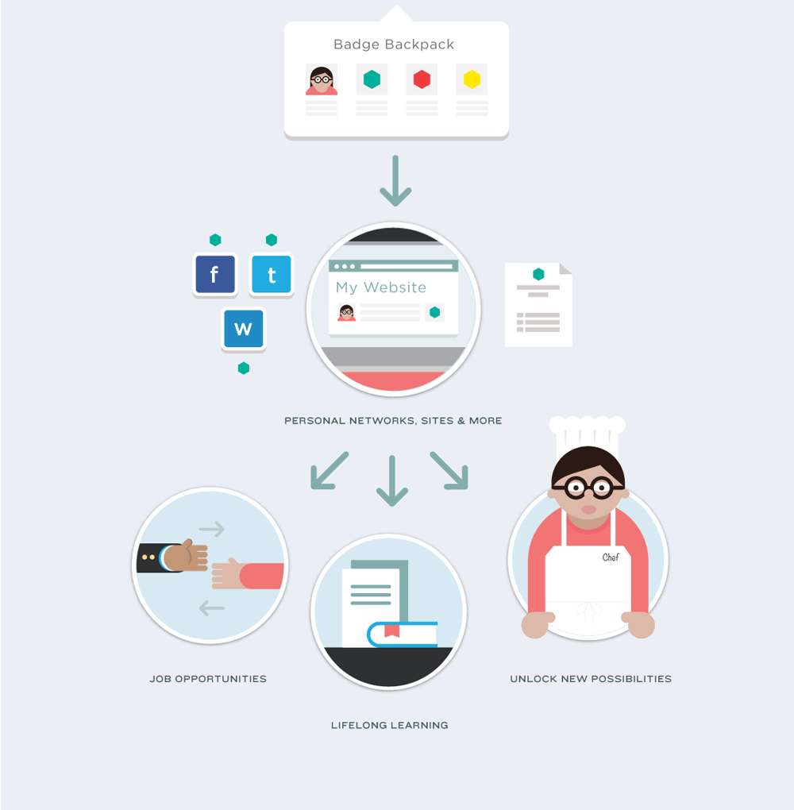

Slide 18
Working Groups
Infrastructure
Infrastructure
Standard
Endorsement
Messaging
Research
Policy
Directory
Ecosystem
Higher Ed.
Workforce
Educators/Prof. Dev.
Cities & Network Systems
Digital / Web Literacies
Globalization

Slide 19
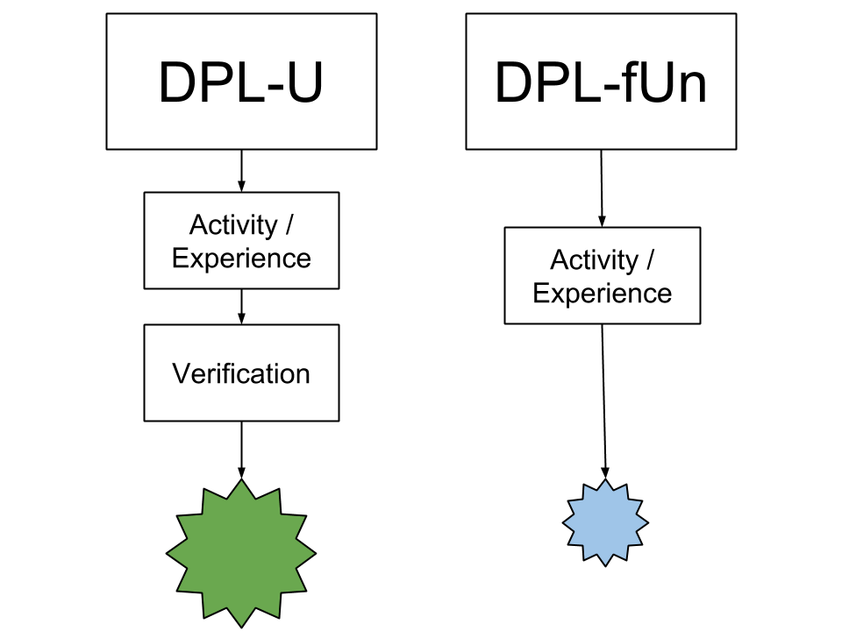

Slide 20
