Slide 1







Fact or Myth?
Device Implementation Is Possible Without the Headache!
Thursday, March 28, 2019
Presented by
Eric Davis
Head of Learning and District Innovation Classcraft
Kinshasa Msola-Marshall
PD Specialist Classcraft
Join the Game-Based Learning community: www.edweb.net/gaming

Slide 2
Here are some edWebinar tips …
Close other applications that use bandwidth or resources on your device.
For audio issues you can switch to phone by clicking the telephone icon at the top of your screen.
Ask a question by clicking the question mark on your screen.
Post in the chat to join the live discussion.
For a larger view of the slides or to hide the chat, click the full screen icon on the upper right of your screen.
If you’re on Twitter tweet using #edWebinar

Slide 3


Join edWeb to Get Your CE Certificate
Your personalized CE certificate will be posted to your edWebinar transcript by the end of the next business day.
Join the community and go to the edWebinar archives for the recording, slides, chat log, and any resources after this edWebinar.
Join at: www.edweb.net/gaming

Slide 4

Game-Based Learning
Join the community on edWeb – it’s free!
www.edweb.net/gaming
Here are some of the many benefits:
View edWebinar recordings
Earn CE Certificates
Download slides and chat logs
Join online discussions
Get free resources
Click on this image for the edWebinar recordings, slides,
chat logs, and resources

Slide 5


Eric Davis, Head of Learning and District Innovation at Classcraft, is a seasoned educator, organizational leader, product designer, fundraiser, thought partner, and professional coach. He specializes in building culture, curriculum, and programs featuring practical strategies in experiential contexts.
Eric Davis
Kinshasa Msola-Marshall, Ed.S., PD Specialist at Classcraft, has been an emerging educational technology specialist for over 15 years. Starting in the field as a technology instructor, she has always been focused on using the right edtech tools to compliment her students’ learning. Recently, her position as the director of academic technology has allowed her to work closely with classroom teachers, principals, and district administrators. Kinshasa has successfully led a brand new technology lab and two 1:1 mobile device programs, and motivated thousands of educators. “Even the most innovative technology tool is useless if no one knows how to use it.”
Kinshasa Msola-Marshall

Slide 6


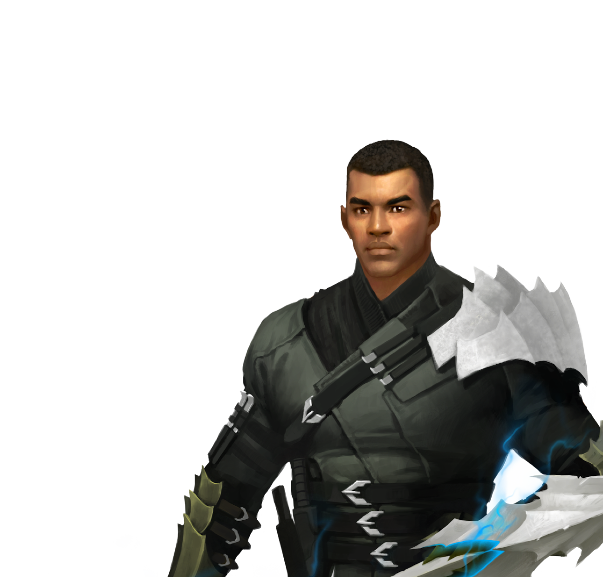
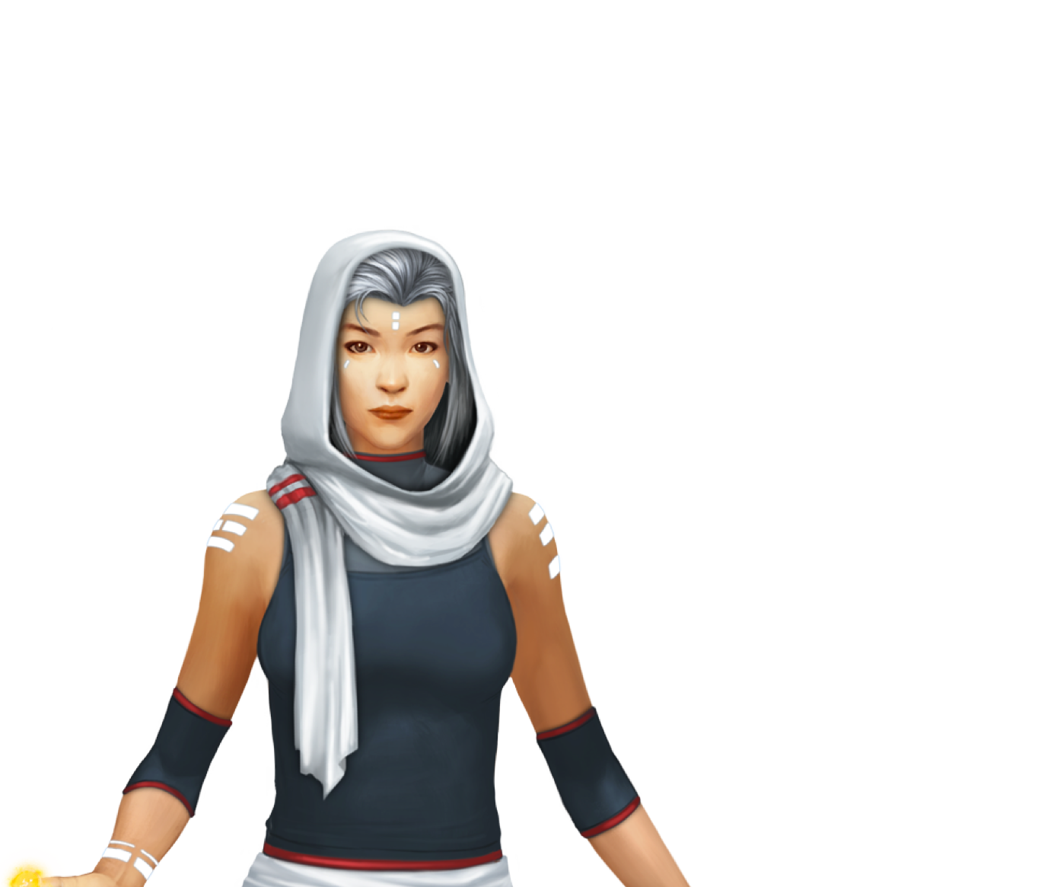



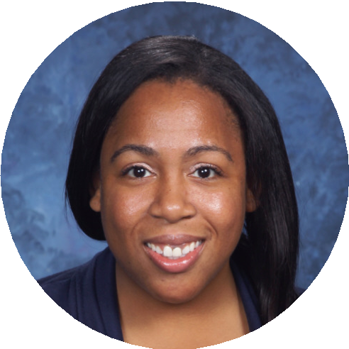





Fact or Myth?
Device Implementation Is Possible Without the Headache!
Presented by the Classcraft Learning Team
Eric Davis & Kinshasa Marshall @classcraftgame eric@classcraft.com kinshasa@classcraft.com

Slide 7

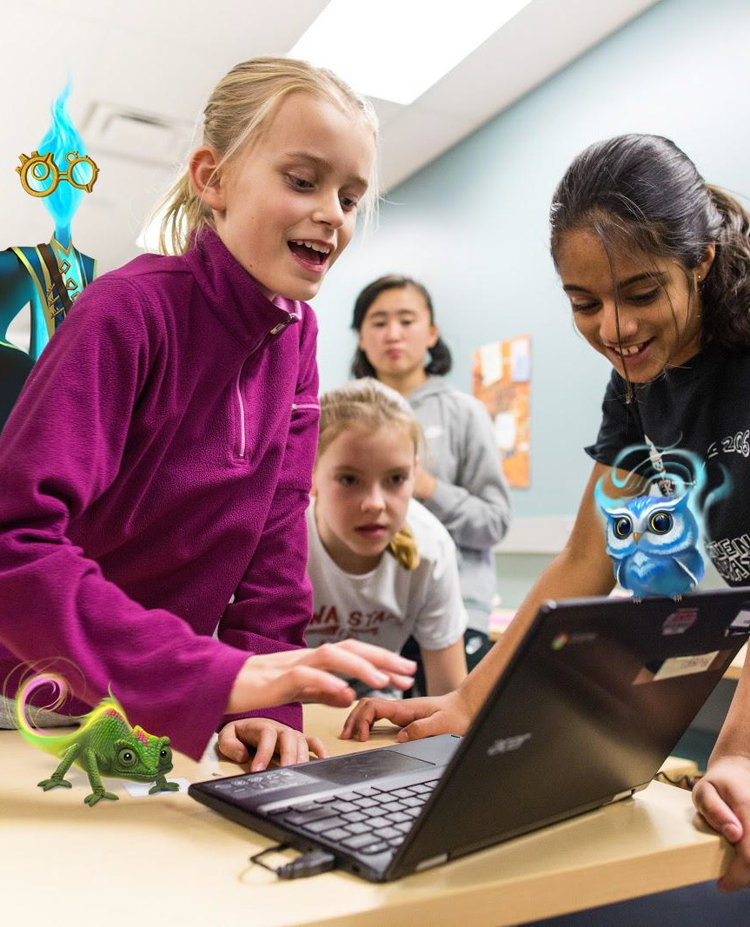
Agenda
Purpose of the study
  Takeaways about why and how gamification impacts positive,
competent, responsible, and thoughtful use of devices
Best Practices for Effective Device Rollouts
Student behaviors checklist

Slide 8

Purpose & Outcomes of the Study, Part 1
The following items specifically address Classcraft’s positive impact, but more importantly, the conclusions extend to gamification of device rollouts in general:
Tasks with motivational gamified mechanics → improvement in 21st-century learning skills, technical competencies, independence, and personal accountability for devices and their readiness
Student-led, independent, and sophisticated use of devices increased roughly 100%
“Gamification as a motivational tool and platform for online delivery of learning activities and resources is a critical element of integrating technology into schools”
Students placed a greater value on their devices being present and ready to use in order to enjoy gamified content
The use of gamification capitalized on the curiosity aspect being at the center of intrinsic motivation -- encouraging students to explore what their devices can do for them in general and what they are capable of given the task, some direction, and a prospective reward

Slide 9
Purpose & Outcomes of the Study, Part 2
The study found the following, in terms of thoughtful, gamified, device implementation and use...
An increase in students’ responsibility and accountability with devices
Improvements to digital literacy as students explore new apps, tools for learning, and become increasingly collaborative in their work
Greater student technical capabilities and awareness
Improved student self-efficacy, independence, and autonomy and use of self-regulation and cognitive strategies to complete tasks
Increase in preparedness for future learning and development of 21st-century skills and digital citizenship
Increase in engagement and achievement through personalized learning experiences and “fun” tasks or ways of completing tasks

Slide 10
Coaching Care
Care ABOUT their device...
What motivates a student to use their device(s) appropriately?
They feel fortunate to have access
They have time & space to “play”
They complete independent work
They collaborate virtually with peers
They connect with the world beyond their neighborhoods and schools
They become more competent and confident
...
Care FOR their device…
What does a student do to protect and be responsible for a device?
Power down device (sleep or shut down)
Charge device
Protect device (in soft/hard shell if transporting)
Keep food/drinks away from device
Clean screen weekly
Update passwords every 90 days (max)
...

Slide 11
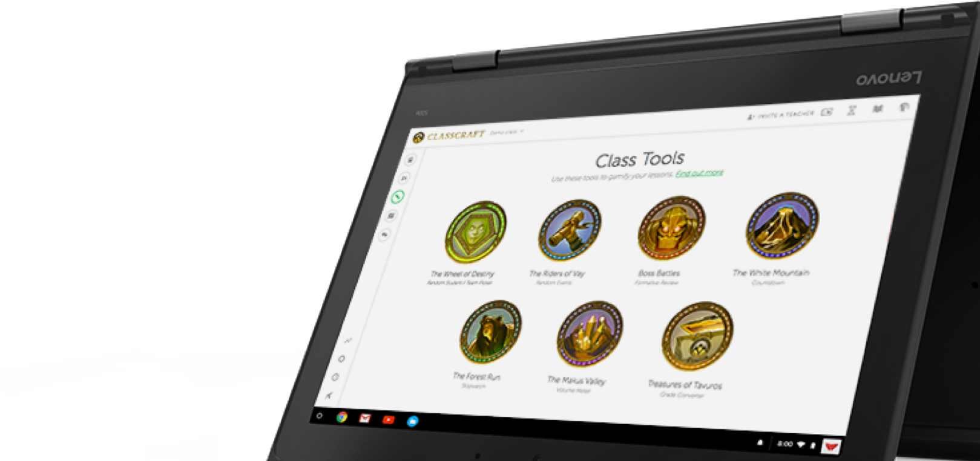


Best Practices for Effective Device Rollout
Planning
Professional Development
Invite Parents
Start Slow
Roll Out!
Continue Learning
Play!

Slide 12

Best Practices - Planning
Research
  Visit Other Schools
  Webinars
  Associations/ Organizations
Hardware

Slide 13
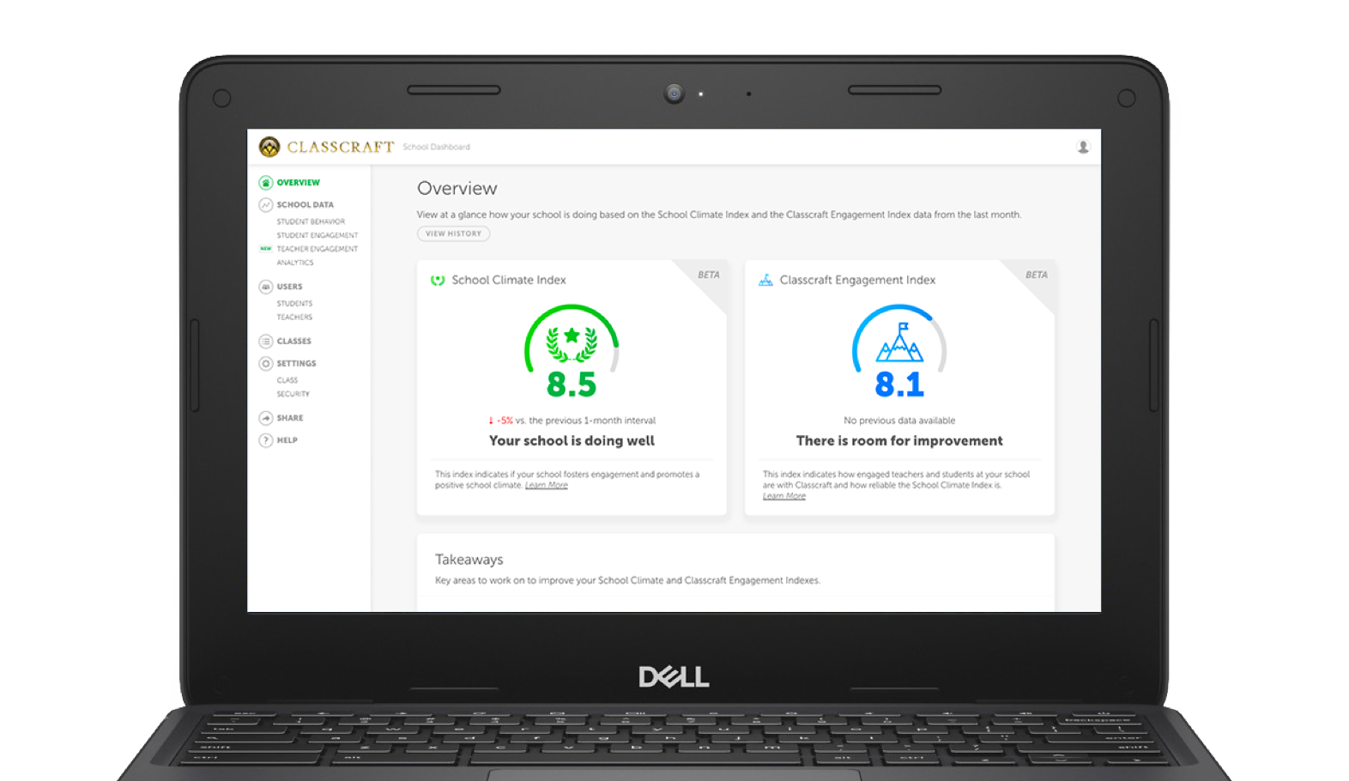
Best Practices - Involve Stakeholders
Involve all stakeholders
  Board members, Admin, Teachers, Parents & Students
  Be Attentive to all needs
  Set policies together

Slide 14
Best Practices - PD
Personalized Professional Development
  Include everyone
  Webinars
  Conferences
  Summer iPad Boot Camp
Planning time

Slide 15

Best Practices - Parent Training
Mandatory Session
  School policies
  Care of devices
  Warranty/insurance
Digital Parenting Sessions
  Common Sense Media
  Devices at home

Slide 16

Best Practices - Start Slow
Implementing a Pilot Program
What is working?
Weekly/ monthly meetings for feedback
Technology Champions
Pause

Slide 17
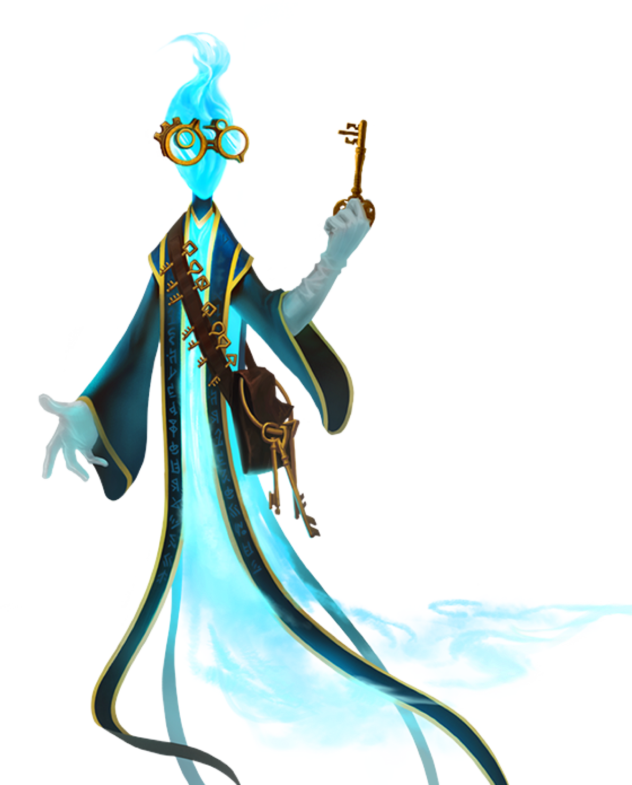
Best Practices - Roll Out
Make it an event
Build Excitement
Student Boot Camp
  Device Management
  Digital Citizenships
  Ending Project

Slide 18

Best Practices - Continue Learning
Learning Never Stops!

Slide 19

Best Practices - Play!
Inspire students to want care for and about devices
Invite them to take ownership of their devices
Give them a safe space to experiment with their devices
Encourage their efforts to become more responsible
Empower them to share ideas and resources
Frame their use of devices as a journey
Honor their efforts to be responsible and develop new skills
Thank them for teaching you!

Slide 20

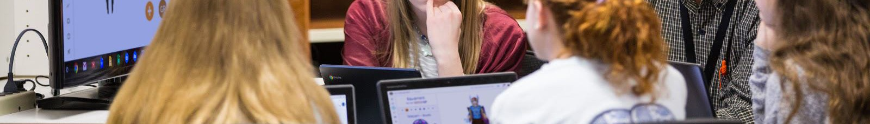
Student Readiness Checklist Part 1
Do students know how to properly care for devices to prevent physical damage?
How and when do students learn to care for their devices? When and with whom do they practice (more than once!!!)?
Are devices present and ready during class to avoid slowing down instruction? If so, what do students do to troubleshoot when tech has issues?
  Ask a peer (“3 Before Me”)
  Ask the teacher
  Stay silent and hope not to be called on

Slide 21
Student Readiness Checklist Part 2
To what extent are students encouraged to solve technical problems on their own? Are the devices more important than experimentation?
Do students understand the value of and demonstrate positive digital citizenship and appropriate behavior?
Do students know how to actively and effectively participate in tasks that require device use?
Do students show interest in developing digital literacy skills, such as working collaboratively, conducting research, collaborating using a range of applications and platforms, etc.
Are students aware of what information and experiences can be shared publicly and which should remain private?

Slide 22
Questions?

Slide 23



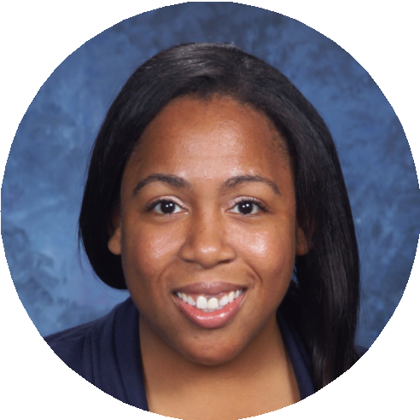



Stay in Touch
Eric Davis
Head of Learning
eric@classcraft.com
Kinshasa Marshall
Learning Team Guru
kinshasa@classcraft.com
classcraft.com facebook.com/classcraftgame @classcraftgame

Slide 24

www.classcraft.com
@classcraftgame
facebook.com/classcraftgame

Slide 25


Thank you for attending!
Eric Davis
Head of Learning and District Innovation
Classcraft
Email: eric@classcraft.com
Kinshasa Msola-Marshall
PD Specialist
Classcraft
Email: kinshasa@classcraft.com
Learn more about Classcraft at www.classcraft.com & @classcraftgame
Give us your feedback on this edWebinar! Click on this link in the chat:
tinyurl.com/edWebinarEval

Slide 26
Join edWeb to Get Your CE Certificate
Your personalized CE certificate will be posted to your edWebinar transcript by the end of the next business day.
Join the community and go to the edWebinar archives for the recording, slides, chat log, and any resources after this edWebinar.
Join at: www.edweb.net/gaming

Slide 27
Game-Based Learning
Join the community on edWeb – it’s free!
www.edweb.net/gaming
Here are some of the many benefits:
View edWebinar recordings
Earn CE Certificates
Download slides and chat logs
Join online discussions
Get free resources
Click on this image for the edWebinar recordings, slides,
chat logs, and resources

